Slide 1
Game programming
Lecture: 5 Textures
By: Rokia Abdein

Slide 2
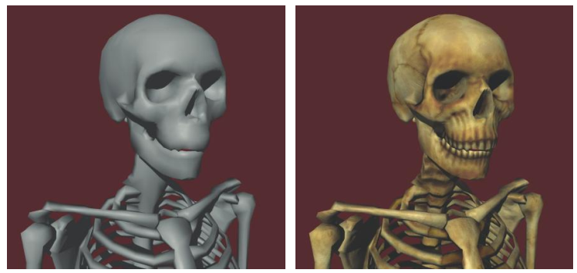


Texture Mapping..
One or more texture maps may be applied to a surface to achieve greater detail, as shown in Figure 7.6. At each point on a surface, a texel (texture pixel) is looked up in each texture map and combined in some way with the lighting formula. In the simplest case, a sample from a diffuse texture map is looked up and used to modulate the diffuse reflection color.

Slide 3
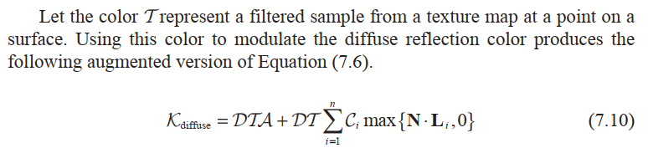
Texture Mapping..

Slide 4
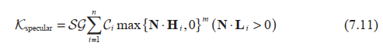
Texture Mapping..
we can also use a texture map to modulate the specular component. Such a map is sometimes called a gloss map and determines the intensity of the specularity at each point on a surface. Using the color G to represent a filtered sample from the gloss map, we can augment the formula for the specular contribution as follows.

Slide 5




Texture Mapping..
The actual color sampled from the texture map is determined by texture coordinates applied to an object. Texture coordinates are either precomputed and stored with each vertex of a triangle mesh or calculated at runtime to produce some special effect.
The texture coordinates are then interpolated across the face of a triangle when it is rendered. There may be from one to four coordinates at each vertex, and they are labeled s, t, p, and q.

Slide 6
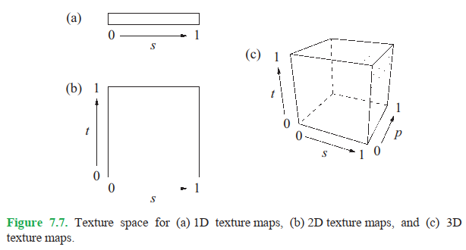


Standard Texture Maps..
One, two, or three texture coordinates may be used to look up texels in one-, two-, or three-dimensional texture maps. As shown in Figure 7.7, the entire width, height, and depth of a texture map corresponds to coordinate values lying between 0 and 1 in the s, t, and p directions, respectively.

Slide 7
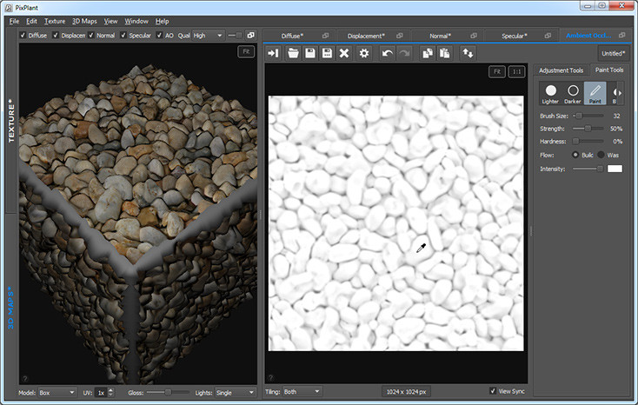
Standard Texture Maps..

Slide 8
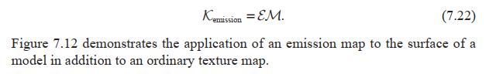
Emission..
Some objects may emit light in addition to reflecting it. To give an object the appearance of emitting a uniform glow, we add an emission color ƹ to our lighting formula. This emission color can also be modulated by an emission map that determines the color and intensity of the glow at each point on a surface. Using the color M to represent a filtered sample from the emission map, the emission component of the lighting formula is given by the simple expression .

Slide 9
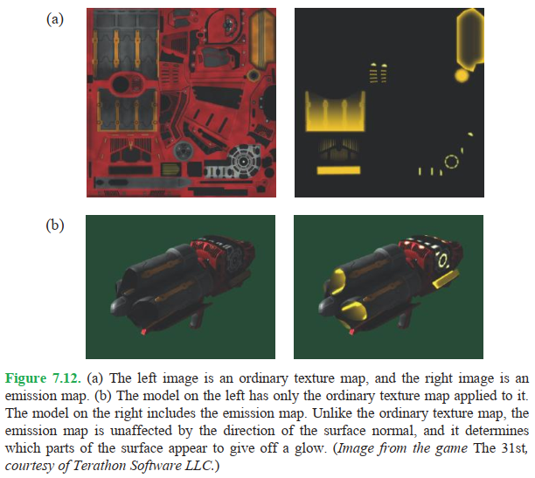
Emission..

Slide 10
Shading Models..
Information about the surface of a model, such as the positions of points on the surface and the normal vectors at those points, are stored only for each vertex of a triangle mesh.
When a single triangle is rendered, information known at each vertex is interpolated across the face of the triangle, as discussed before.

Slide 11
Shading Models..
Conventional lighting pipelines calculate diffuse and specular illumination only at the vertices of a mesh. More modern graphics hardware enables the calculation of the entire illumination formula at every individual pixel drawn to the display.
The manner in which lighting is determined for the surface of a triangle, combined with any number of texture maps, is called shading.

Slide 12
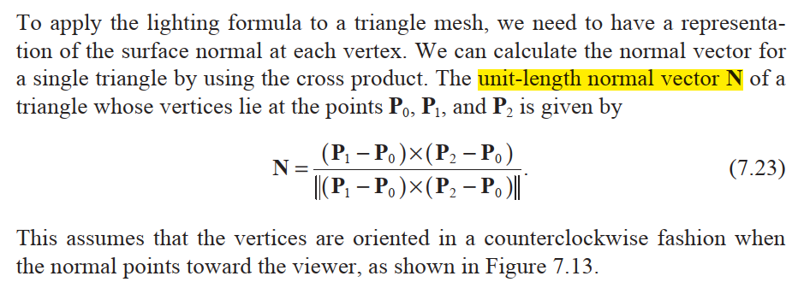

Calculating Normal Vectors..

Slide 13
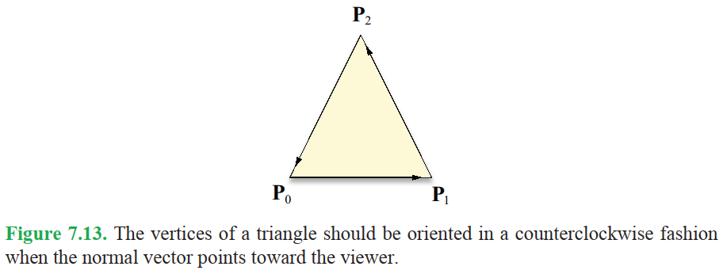



Calculating Normal Vectors..

Slide 14
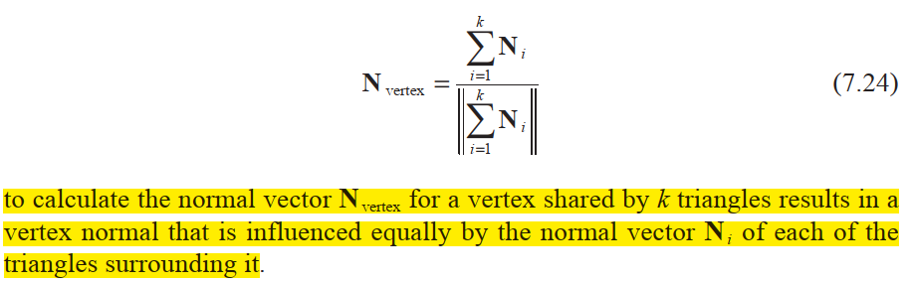





Calculating Normal Vectors..
The normal vector at a single vertex is typically calculated by averaging the normal vectors of all triangles that share that vertex. Using the formula:

Slide 15
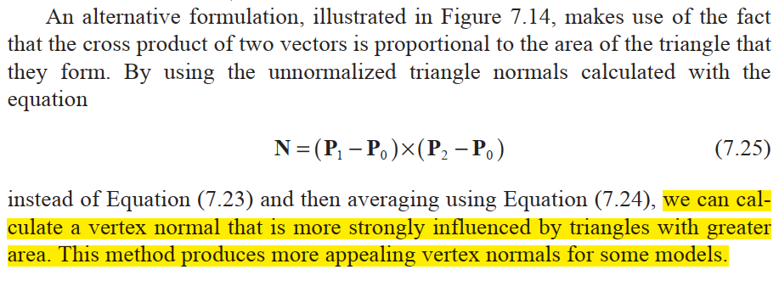


Calculating Normal Vectors..

Slide 16
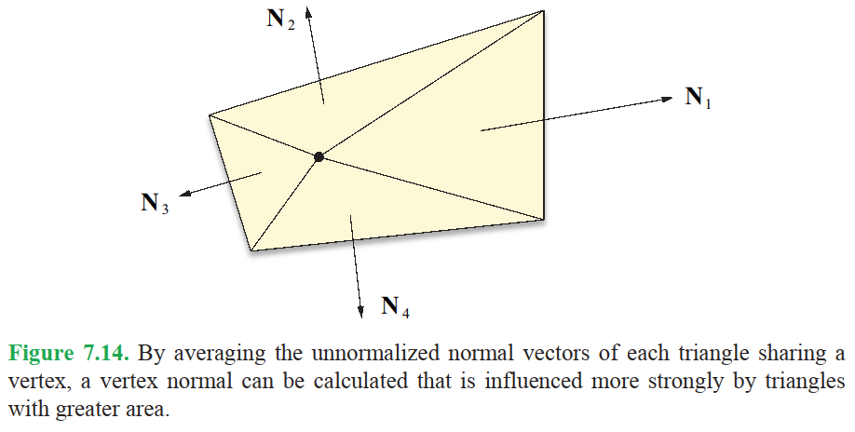

Texture Mapping..

Slide 17
Gouraud Shading..
The interpolation of lighting values calculated at each vertex across the face of a triangle is known as Gouraud shading.
Before the advent of graphics hardware capable of performing per-pixel lighting calculations, diffuse and specular colors were calculated only at each vertex of a triangle mesh. This method calculates the colors

Slide 18
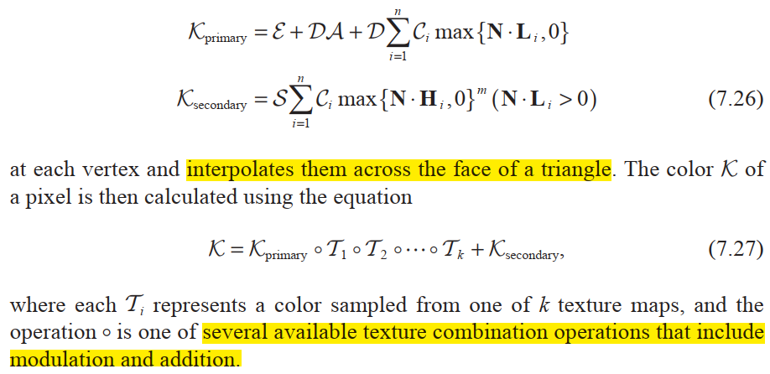

Gouraud Shading..

Slide 19
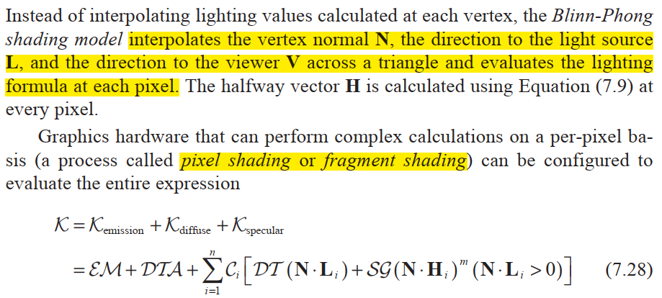




Blinn-Phong Shading..
at each pixel composing the face of a triangle.

Slide 20
Blinn-Phong Shading..
An advantage that Blinn-Phong shading possesses over Gouraud shading is that it does a far better job of modeling specularity due to the fact that the dot product N . H is evaluated at every pixel.
When a sharp specular highlight falls in the interior of a triangle, Gouraud shading produces poor results because the specular component calculated at the triangle’s vertices is unrepresentative of the true values existing elsewhere on the face of the triangle.

Slide 21

Bump Mapping..
The surface detail that an observer perceives when an object is viewed from any direction other than edge-on is generally determined by the way in which its surface is illuminated.
The illumination at each pixel rendered is determined by the normal vector used during the evaluation of the lighting formula.
So far, we have been limited to calculating normal vectors only at the vertices of a triangle mesh and using a smoothly interpolated normal vector elsewhere.
This coarse resolution prevents us from illuminating any details that are smaller in size than a typical triangle in a mesh.

Slide 22
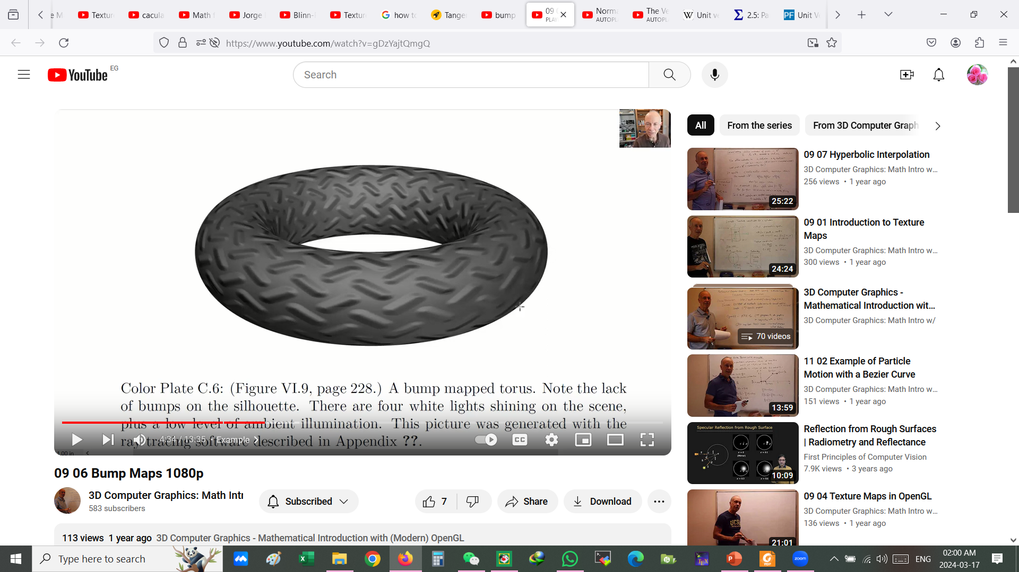




Bump Mapping..
Bump mapping is a technique that presents the illusion of greater detail to the viewer by using a texture map to perturb the normal vector at each pixel.

Slide 23






Bump Map Construction..
High-resolution information about how the normal vector is perturbed is stored in a two-dimensional array of three-dimensional vectors called a bump map or normal map.
Each vector in the bump map represents the direction in which the normal vector should point relative to the interpolated normal vector at a point inside the face of a triangle.
The vector <0,0,1> represents an unperturbed normal, whereas any other vector represents a modification to the normal that affects the result of the lighting formula.

Slide 24
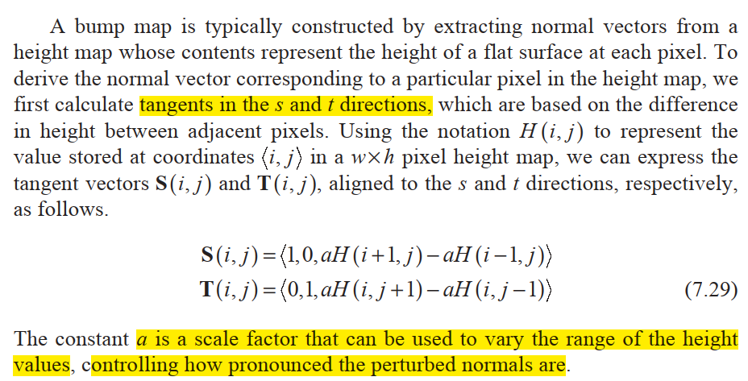



Bump Map Construction..

Slide 25
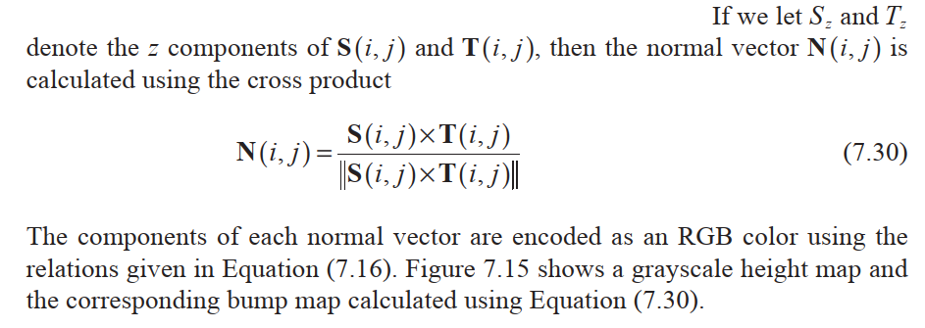
Bump Map Construction..

Slide 26
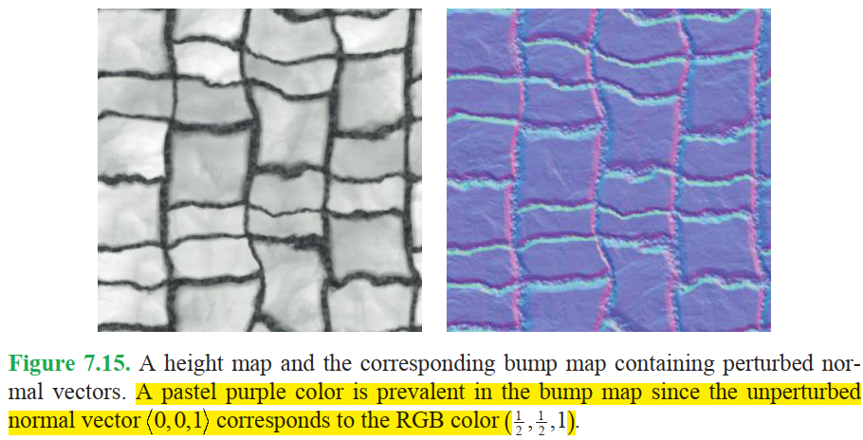



Bump Map Construction..

Slide 27
Tangent Space..
Since the vector 0,0,1 in a bump map represents an unperturbed normal, we need it to correspond to the interpolated normal vector that we would ordinarily use in the lighting formula.
This can be achieved by constructing a coordinate system at each vertex in which the vertex normal always points along the positive z axis. In addition to the normal vector, we need two vectors that are tangent to the surface at each vertex in order to form an orthonormal basis.
The resulting coordinate system is called tangent space or vertex space.

Slide 28
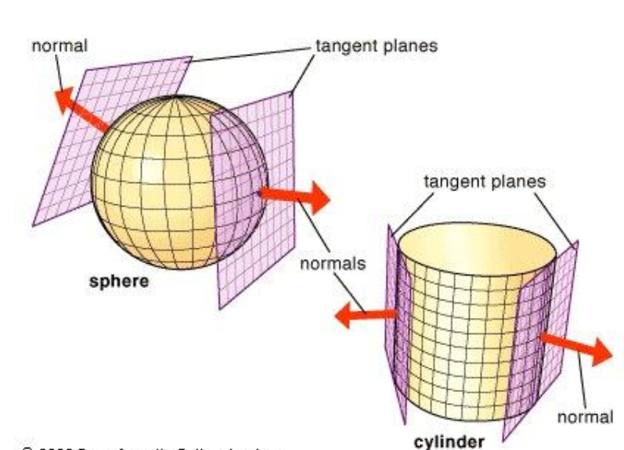




Tangent Space..

Slide 29


Calculating Tangent Vectors..
Our goal is to find a 3⋅ 3 matrix at each vertex that transforms vectors from object space into tangent space. To accomplish this, we consider the more intuitive problem of transforming vectors in the reverse direction from tangent space into object space. Since the normal vector at a vertex corresponds to 0,0,1 in tangent space, we know that the z axis of our tangent space always gets mapped to a vertex's normal vector.

Slide 30
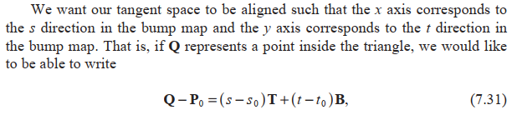
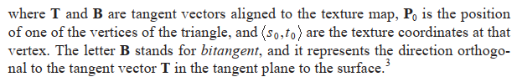



Tangent Space..

Slide 31









Slide 32
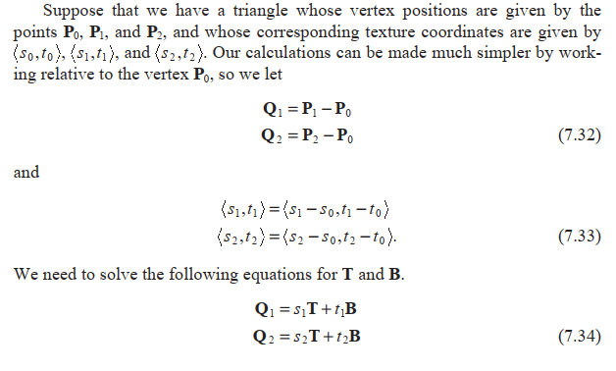
Tangent Space..

Slide 33
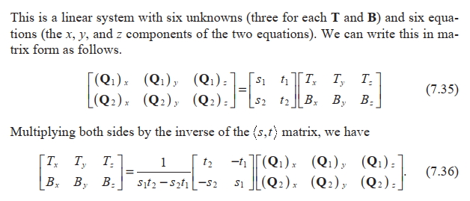



Tangent Space..

Slide 34

Tangent Space..
This gives us the (unnormalized) T and B tangent vectors for the triangle whose vertices are P0, P1, and P2.
To find the tangent vectors for a single vertex, we average the tangents for all triangles sharing that vertex in a manner similar to the way in which vertex normals are commonly calculated.

Slide 35
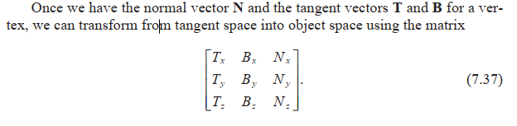

Tangent Space..
To transform in the opposite direction (from object space to tangent space—what we want to do to the light direction), we can simply use the inverse of this matrix.

Slide 36
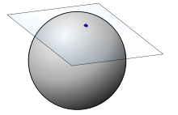
Tangent Space..
First of all, for every 3D vertex there is infinite tangent and bi-tangent vectors. The below image explains why there is an infinite number of tangent spaces for each vertex, the tangent and bitangent can have any direction in the shown plane.

Slide 37
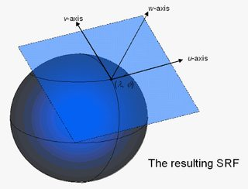
Tangent Space..
So in order to properly calculate the most useful1 tangent space, we want our tangent space to be aligned such that the x axis (the tangent) corresponds to the u direction in the bump map and the y axis (bitangent) corresponds to the v direction in the bump map, we should already have normal of the vertex which already corresponds to the Z direction in tangent space.
That best be explained with pictures, we want our tangent space to be aligned like (u, v) shown below.

Slide 38
Tangent Space..
In computer graphics developers usually use (u,v) also known as texture coordinates. We will assume T is the tangent and B is the bitangent, and P0 is our target vertex, that is part of the triangle (P0,P1,P2).
First remember what we wanted to do, is to calculate tangent and bitanget that:
T aligned with u and B aligned with v.
T and B lays in the plane with the vertex normal

Slide 39
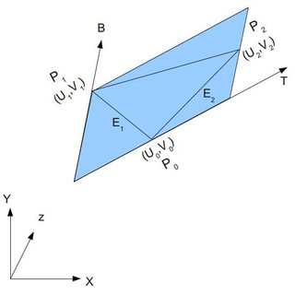
Tangent Space..
The point is we already assumed that T and B lays in the same plane and corresponds to U and V now if we can know their values we can cross product and the third vector to construct a transformation matrix from world to tangent space.

Slide 40
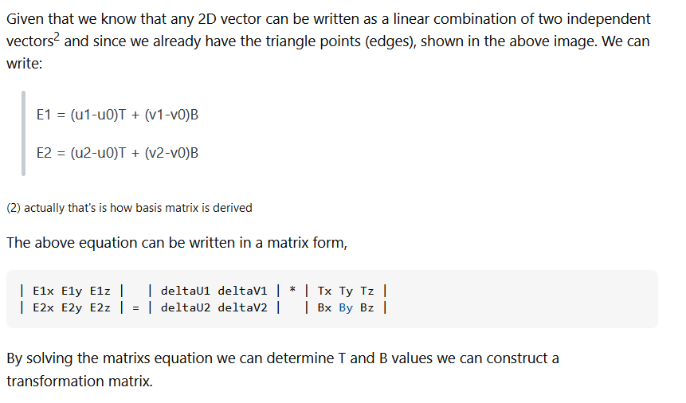
Tangent Space..

Slide 41
A Physical Reflection Model..
The manner in which we have calculated the reflection of light on a surface before this point is computationally cheap and produces visually pleasing results in many cases, but it is not an accurate model of the physically correct distribution of reflected light. Achieving greater realism requires that we use a better model of a surface’s microscopic structure and that we apply a little electromagnetic theory.

Slide 42
Bidirectional Reflectance Distribution Functions..
In general, our goal is to model the way in which the radiant energy contained in a beam of light is redistributed when it strikes a surface.
Some of the energy is absorbed by the surface, some may be transmitted through the surface, and whatever energy remains is reflected.
The reflected energy is usually scattered in every direction, but not in a uniform manner.
A function that takes the direction L to a light source and a reflection direction R, and returns the amount of incident light from the direction L that is reflected in the direction R is called a bidirectional reflectance distribution function (BRDF).

Slide 43
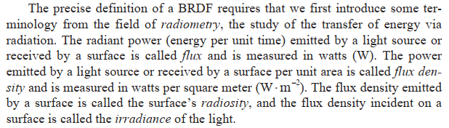
Bidirectional Reflectance Distribution Functions..

Slide 44
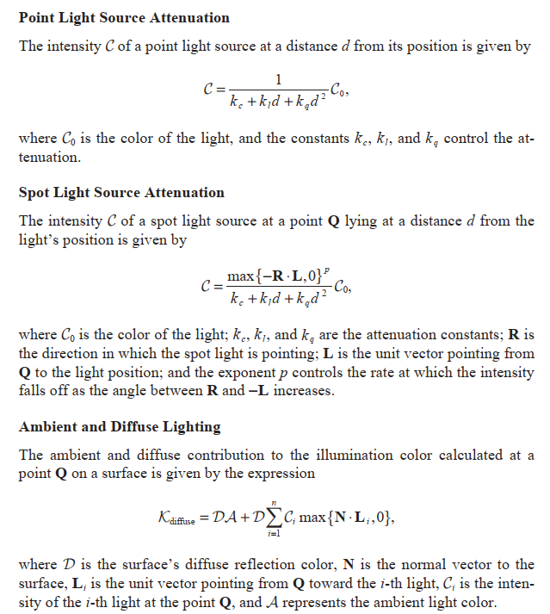

Slide 45
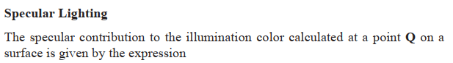
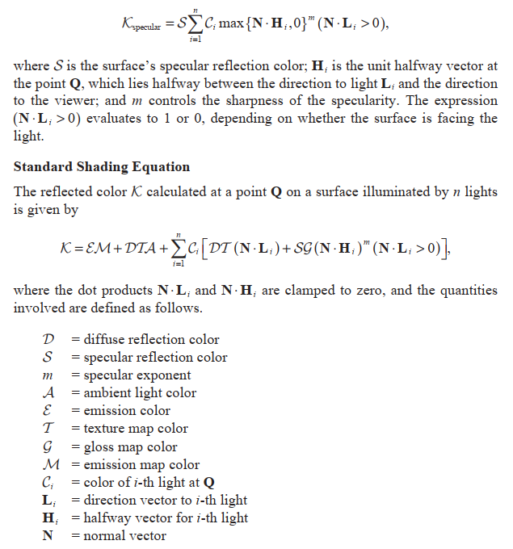

Slide 46
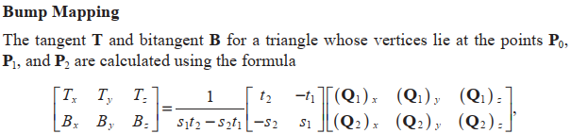

Slide 47
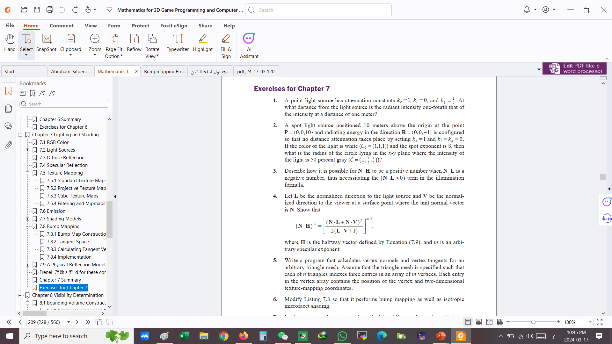


Slide 48

Midterm Exam
The exam score is 20
8 scores for 4 theoretical questions (i.e., definitions), 2 scores each.
7 scores MCQ
5 scores for 2 exercises.

Slide 49
